Slide 1
jQuery – Coding Practice
CCAPDEV
Web Application Design & Development

Slide 2
Activities
Form Validation Redux
Rock-Paper-Scissors Redux
Mini Journal

Slide 3
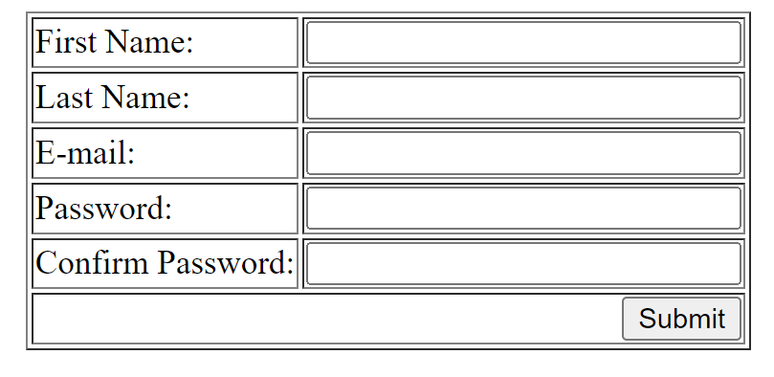
Activity #1 – Form Validation REDUX
1_form.html

Slide 4
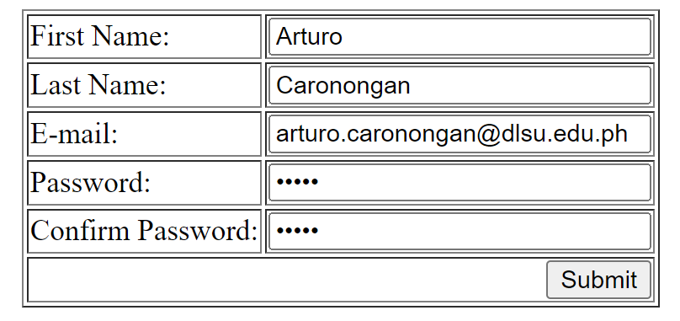
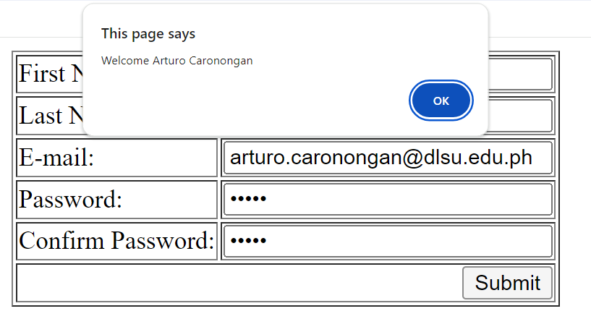
Activity #1 – Form Validation REDUX
A simple form application
When every entry is filled properly, greet the user via their full name (First + Last Name) then redirect the user to google.com

Slide 5
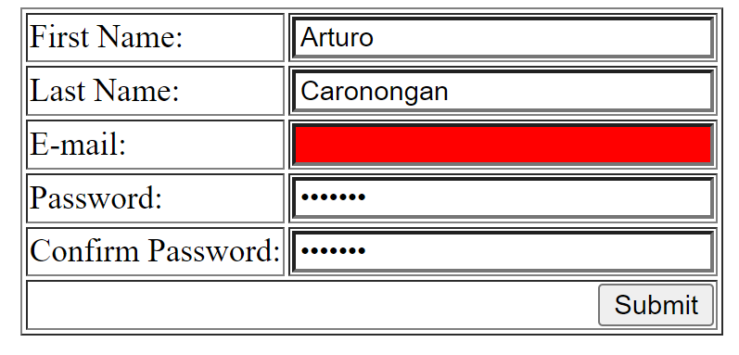
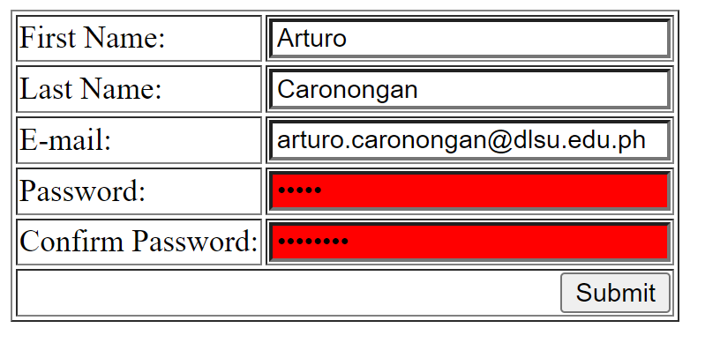
Activity #1 – Form Validation REDUX
Otherwise:
Highlight empty fields with the color red
Highlight both password fields with the color red if they do not match

Slide 6
Activity #1 – Form Validation REDUX
The Catch:
You are given the solution In Javascript
Convert the solution into its jQuery equivalent

Slide 7
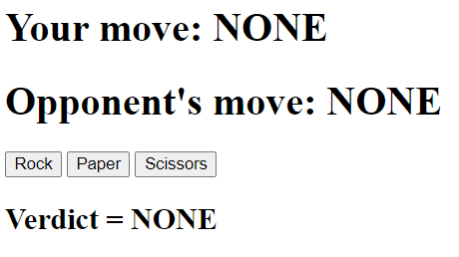

Activity #2 – Rock, Paper, Scissors! REDUX
2_rps.html

Slide 8
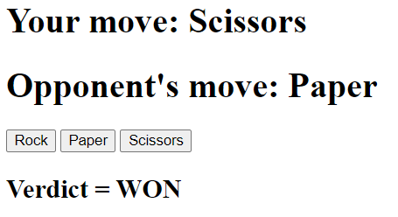
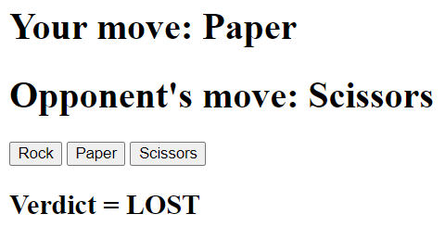
Activity #2 – Rock, Paper, Scissors! REDUX
Create a very simple “Rock-Paper-Scissors” Text-based game
Be as creative as you want with this! Add images, points, etc.

Slide 9
Activity #2 – Rock, Paper, Scissors! REDUX
The Catch:
You are given the solution in Javascript
Convert the solution into jQuery equivalent

Slide 10
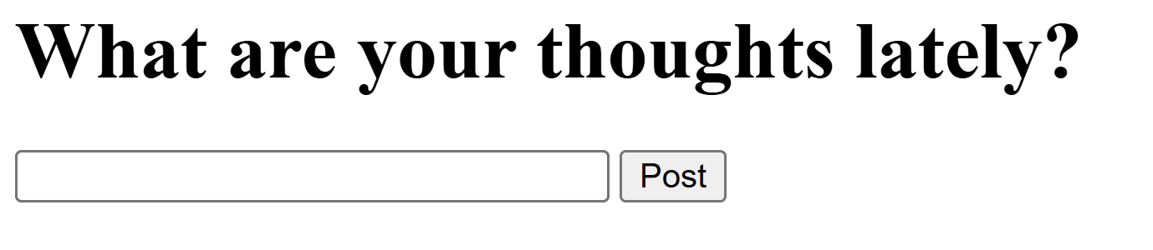
Activity #3 – Mini Journal
Create a mini-journal application using jQuery
3_journal.html

Slide 11
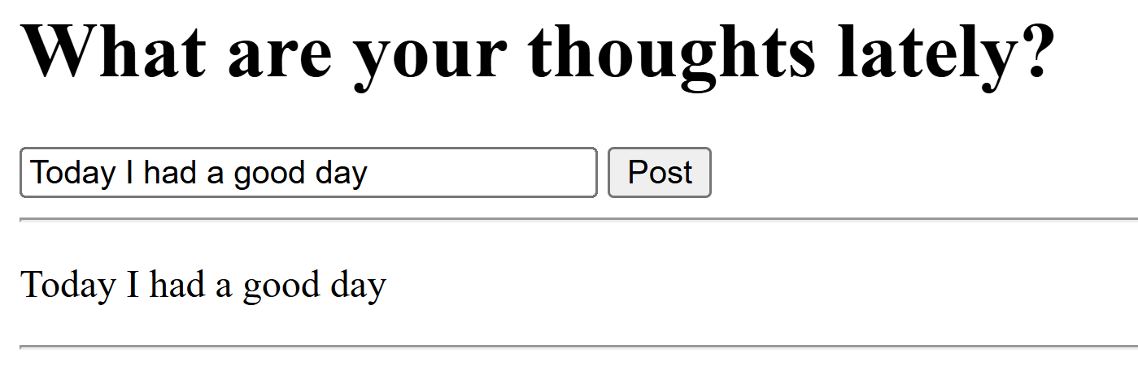
Activity #3 – Mini Journal

Slide 12
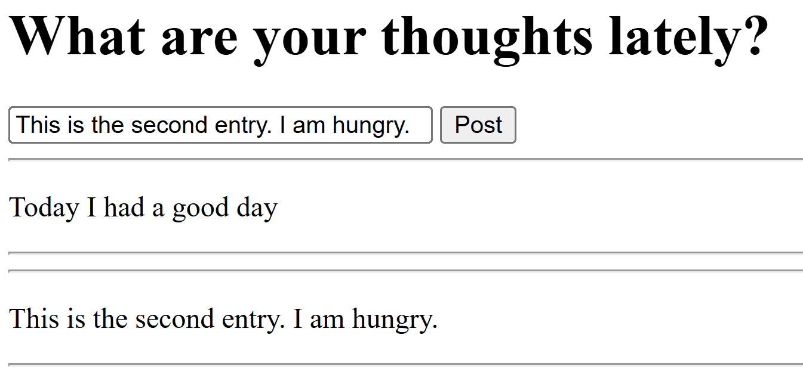
Activity #3 – Mini Journal

Slide 13
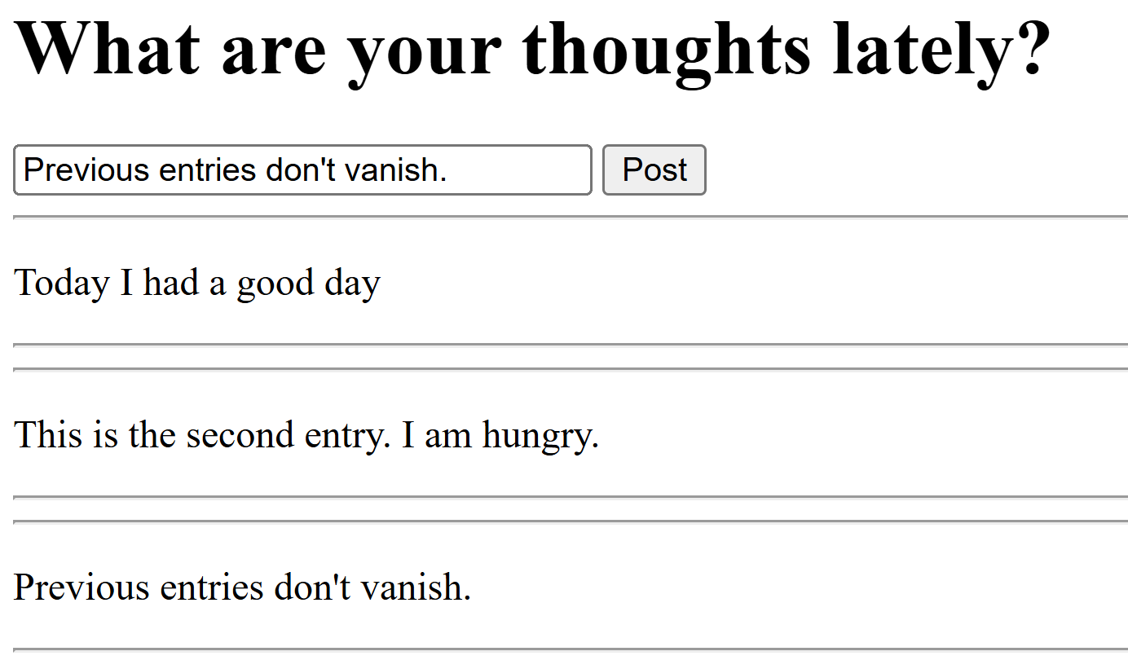
Activity #3 – Mini Journal

Slide 14
Activity #3 – Mini Journal
The Catch:
You are provided with a skeleton code
Complete the function post_entry() with the correct jQuery code
(Note: There are SEVERAL approaches that can be made)

Slide 15
FINISHED EARLY?
Mini Challenge #1 this Thursday (S18 & S19) – Class time
Please attend YOUR respective classes
S18: 11:00 – 12:30
S19: 12:45 – 14:15
Coverage: HTML & CSS

Slide 16
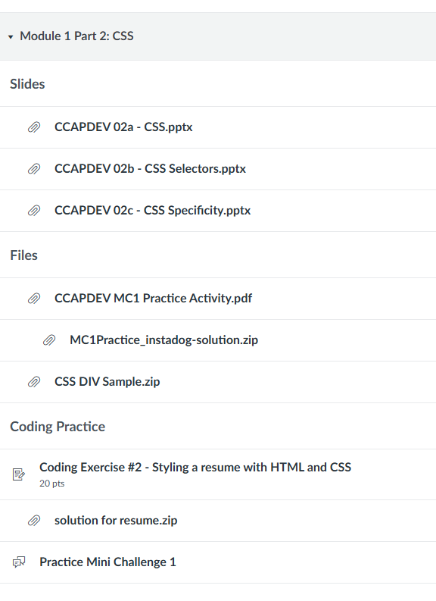
FINISHED EARLY?
References for MC1:

Slide 17
FINISHED EARLY?
Roadmap
2/5/2026 = Mini Challenge #1
Dowload Node.js AND MongoDB at this point over the weekend
2/9/2026 = JSON & Fetch & AJAX w/ Node.js intro
2/12/2026 = MCO1 Demo
2/16/2026 = Client Server Architecture & More Node.js

